Slide 1
Cloudamize
Results Overview
Created on September 02, 2026 for Example Customer

Slide 2

Contents
Assessment Summary
Financial Summary
Additional Savings
Storage Assessment
EOL Assessment
Modernization Options
Business Value
Notes:
#{{keep-if-no-tam}}

Slide 3
1.
Assessment Summary

Slide 4


Cloudamize Overview
Industry leader & Cloud Service Provider Partner for over a decade
Supporting ~700 assessments / migrations annually
Influencing ~$1B in CSP Spend
Globally positioned support and engineering teams to enable in-region support for customers and partners

Slide 5
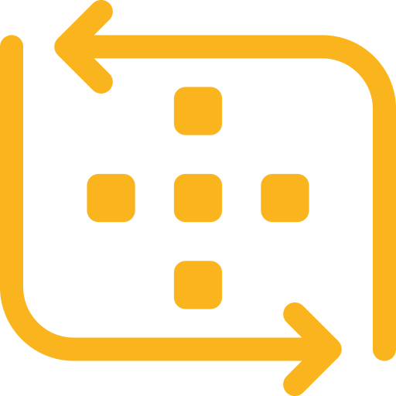

Assessment Overview
Total Servers Assessed: 242
Servers Assessed via Agent/Agentless: 241
Servers Assessed via vCenter/Hyper-V: 188
Windows Servers in Scope: 75
Linux Servers in Scope: 167
Storage (TB): 73.2TB
Storage Utilization (TB): 43.1TB
SQL Server Overview
Enterprise: 0
Standard: 2
Web: 0
Applications Discovered: 329
Business Applications Defined: 0
Excluded from Scope;
Removed from Scope: 93
Zombie Machines: 128
(see Zombie Machine Analysis)
Cloudamize License Period
Started: January 12, 2026
Ended: April 03, 2026
Data Collection Period (11 Days)
Started: February 11, 2026
Ended: February 22, 2026
Live Pricing Calculated on: February 26, 2026
If this number seems high, we encourage the use of the Cloudamize Plan component to remove the non-business level applications.
Notes:
#{{keep-if-no-tam}}

Slide 6
2.
Financial Summary

Slide 7
Financial Overview
Infrastructure Modernization + Licensing Optimization + Savings Plan Commitment
Savings Levers & Subtotals (Annual) | Azure Hybrid Benefit for OS & SQL | SQL License Included (No Azure Hybrid Benefit)
Lift & Shift Annual Estimate, Pay-as-you-go Pricing | $609K | $609K
Savings by Applying Cloudamize Instance Rightsizing, Pay-as-you-go Pricing | ⬇ $335K (55% Savings) | ⬇ $335K (55% Savings)
Savings from 3 year Reservation Plan Commitment | ⬇ $139K (51% Savings) | ⬇ $100K (37% Savings)
TOTAL Annual Estimate w/ 3 year Reservation Plan Commitment | $135K (⬇$474K / 78%) | $174K (⬇$435K / 71%)
* SQL BYOL model does not include costs paid to Microsoft for SQL licensing. Add BYOL costs to the SQL BYOL option to understand apples to apples comparison.
Notes:
#{{delete-if-no-tam}}

Slide 8
Financial Overview
Reservations Plan Comparison (Licence Costs Included)
 | Annual Cost | Cost Difference | Compute | *Storage | **Network
Pay-as-you-go Hardware Lift & Shift | $609K |  | $557K | $50K | $1K
Pay as you go Right Sized | $274K | $335K | $234K | $39K | $1K
1-Year RI Right Sized | $195K | $413K | $155K | $39K | $1K
3-Year RI Right Sized | $174K | $435K | $127K | $45K | $1K
* Storage costs provisioned at 100% utilized
** Traffic costs are estimated at 10% of total egress traffic.
Notes:
Additional possible savings
Optimized Cores (Available Cores - Recommended Cores) * MSRP of SQL licenses and SA
Downgrade SQL (BYOL) Available Cores * MSRP of SQL license for non-prod machines
Downgrade SQL (LI) Sum of SQL licenses for non-prod machines
Reduce non-prod 70% of the compute of all non-prod machines (assumes these machines will only be running 30% of the time)

Slide 9
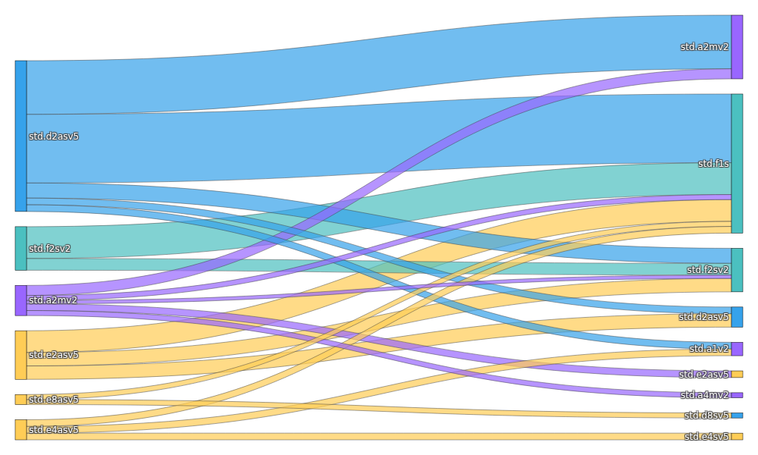
Financial Overview (Cont.)
Infrastructure Modernization Optimization Specifics
Hardware Mapping
(Lift & Shift)
Workload Mapping
(Cloudamize Right-Sized)
This chart shows the transition of machine instance families from a “lift and shift” migration to a workload utilization optimized, or “Right Sized” migration.
Model Notes
Tenancy: Shared
Target Peak CPU Threshold: 80%
Storage Capacity Scaling: 100%
Network Load Factor: 10%

Slide 10
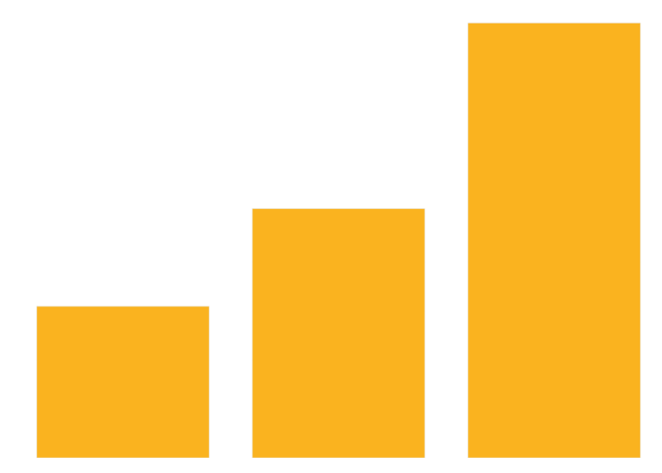
Financial Overview (Cont.)
Optimization Logic & Constraints
CPU Constrained Machines | 31
Memory Constrained Machines | 51
CPU & Memory Constrained Machines | 89
Notes:
The Constraint is the main reason Cloudamize cannot recommend the next smallest Azure VM instance.
A smaller Azure VM instance would face performance issues such as CPU, Memory, or Disk IO.

Slide 11
3.
Additional Savings

Slide 12
4.
Storage Assessment

Slide 13
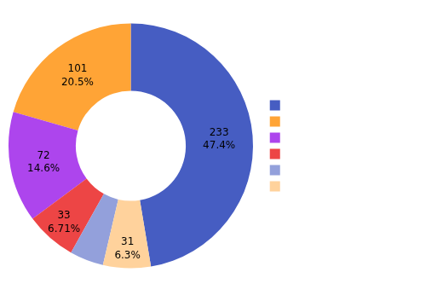
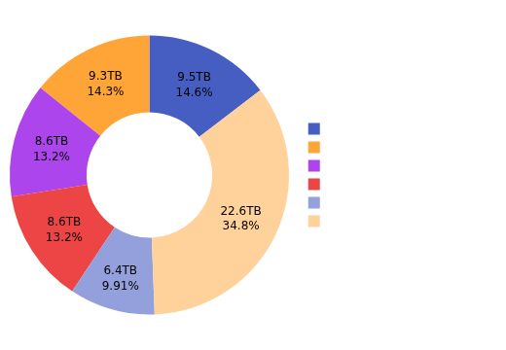
Storage Analysis
Total Disk Capacity | 73.2TB
Total Disk Occupancy | 43.1TB
Recommended Total Disk Occupancy | 65.0TB
We use 100% disk occupancy for an initial TCO. If you’d like to increase this, we can customize your TCO to add storage headroom.
41%
Reduction in Storage via Cloudamize Optimization

Slide 14
5.
EOL Assessment

Slide 15
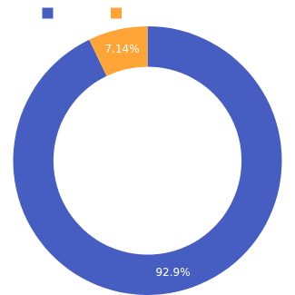

Microsoft End-of-Life (EOL) Analysis
Windows Server Version | Count | OS Support Cycle | End of Ext. Support | Risk
<= 2012 R2 | 1 | Unsupported | October 10, 2023 | High
2016 | 13 | Extended Support | January 12, 2027 | Med
2019 | 0 | Extended Support | January 09, 2029 | Med
2022 | 0 | Supported until October 13, 2026 | October 14, 2031 | Low
2025 | 0 | Supported until October 9, 2029 | October 10, 2034 | Low
SQL Server Version | Count | DB Support Cycle | End of Ext. Support | Risk
<= 2014 | 0 | Unsupported | July 9, 2024 | High
2016 | 0 | Extended Support | July 14, 2026 | Med
2017 | 0 | Extended Support | October 12, 2027 | Med
2019 | 0 | Extended Support | January 8, 2030 | Med
2022 | 0 | January 11, 2028 | January 11, 2033 | Low

Slide 16
6.
Modernization Options

Slide 17
7.
Business
Value

Slide 18

Zombie Server Analysis
Servers that are on, but contain < 20% usage
128
Servers with less than 20% usage
NOTE: Cloudamize identified these as Zombie servers based on the fact that they are running with extremely low usage. We highly suggest examining the server’s role to validate and justify the server cost in Azure VM in order to confirm that they can be safely shutdown without impacting day-to-day operations.

Slide 19

Top Zombie Servers
Servers that are on, but contain < 20% usage
$168K
Potential on-Demand Savings within the 0-20% usage group
Names Removed from Example Deck
Next Steps
Investigate & confirm whether these are truly unused servers. The Cloudamize Plan component can be used to review all application dependencies on a server.
If you’re interested in an updated Cloudamize TCO, you can remove the instances from the assessment scope in the settings page.

Slide 21
Appendix: Using Cloudamize to help with the Next Steps
A.

Slide 22



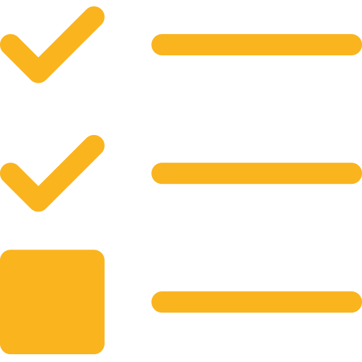

Platform Overview
See following slides for more information
Azure Support Coming Soon!
DISCOVER
3 standard data collection methods plus advanced SQL telemetry collection. Now including NetApp integration!
ANALYZE
Explore various TCO plans, or create your own custom plan, to reduce your lift-&-shift cost by >50%.
PLAN
Explore application & server dependencies to intelligently group by Application, Wave, or 7R.
MIGRATE
Connect to the Cloud, Replicate Servers, and Apply Right-Sizing, all from within Cloudamize.
MANAGE
Orchestrate all of your team’s assessment, planning, and migration activities with Runbooks.
MODERNIZE
Continuous in-cloud real-time modernization recommendations as you continue to grow your cloud estate.
After tagging your customer business applications, use the new Application Catalogue to add meaningful metadata & context
Need help planning the end-to-end migration activities? Cloudamize Runbooks (beta) are now available!

Slide 23
A1.
PLAN

Slide 24
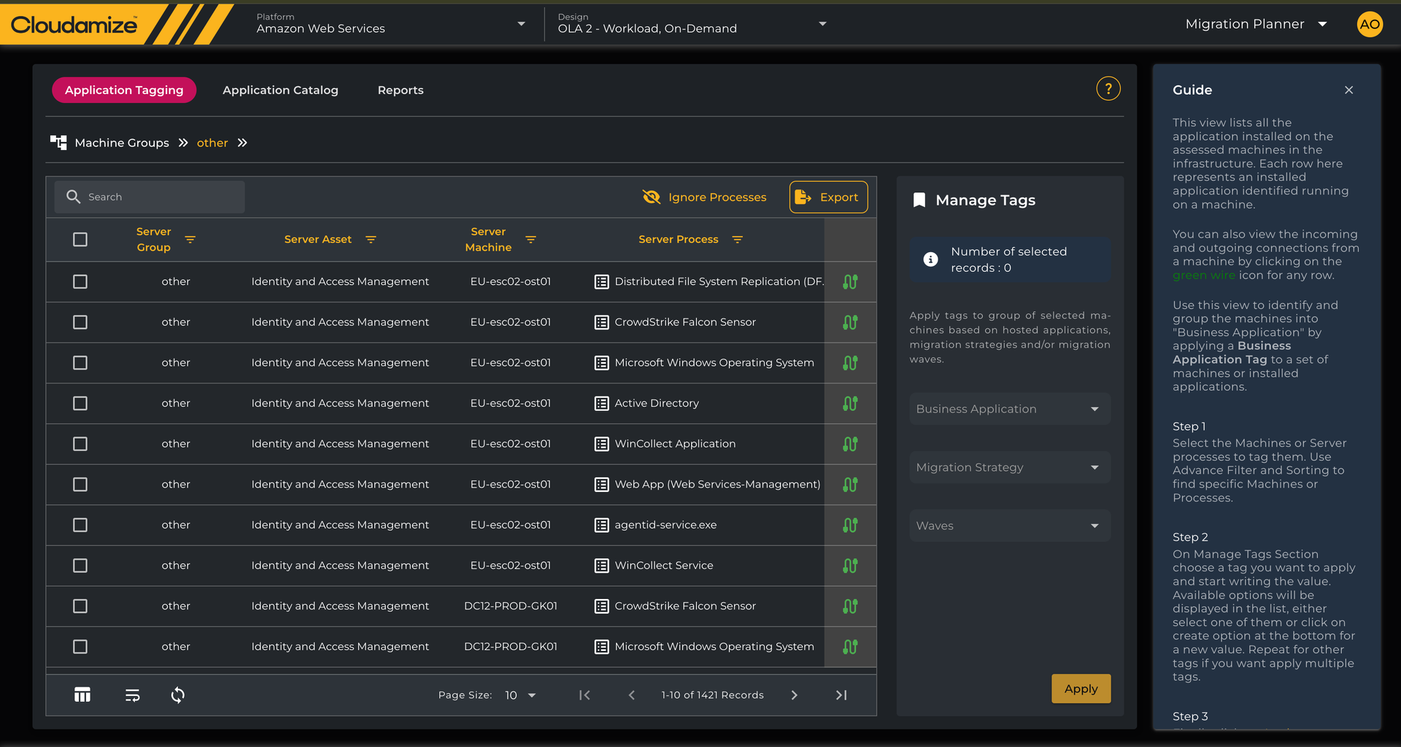
Wave, 7R, & Application Tagging
Advanced Filtering, enabling quick filtering by a specific Process
Once filtered, you can quickly Tag all instances with a Business Application Name, place them in a Move Group, and/or classify them with a 7R strategy

Slide 25
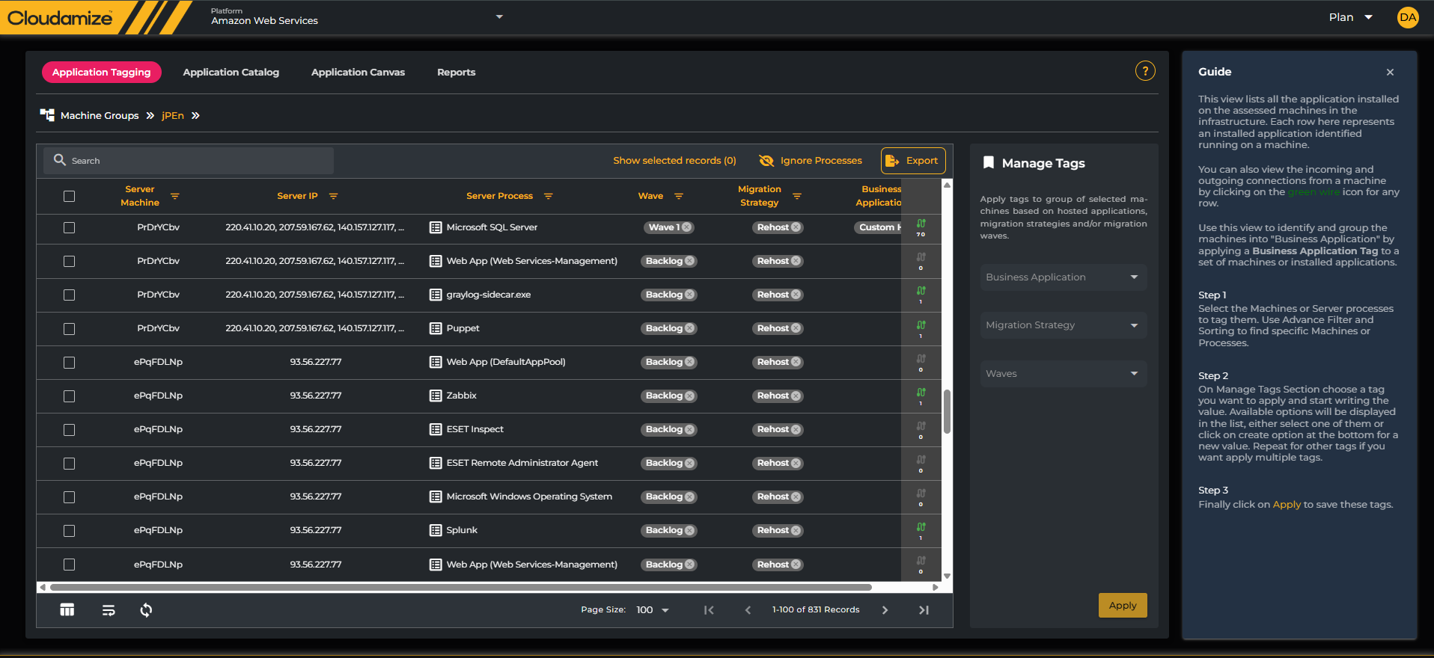
Wave, 7R, & Application Tagging
Easily filter and sort by Machine Name, IP, Process/Application Name, or any of the tags
Quickly remove the noise
Quickly identify where there are dependencies, and click on the icon to view and select dependencies

Slide 26
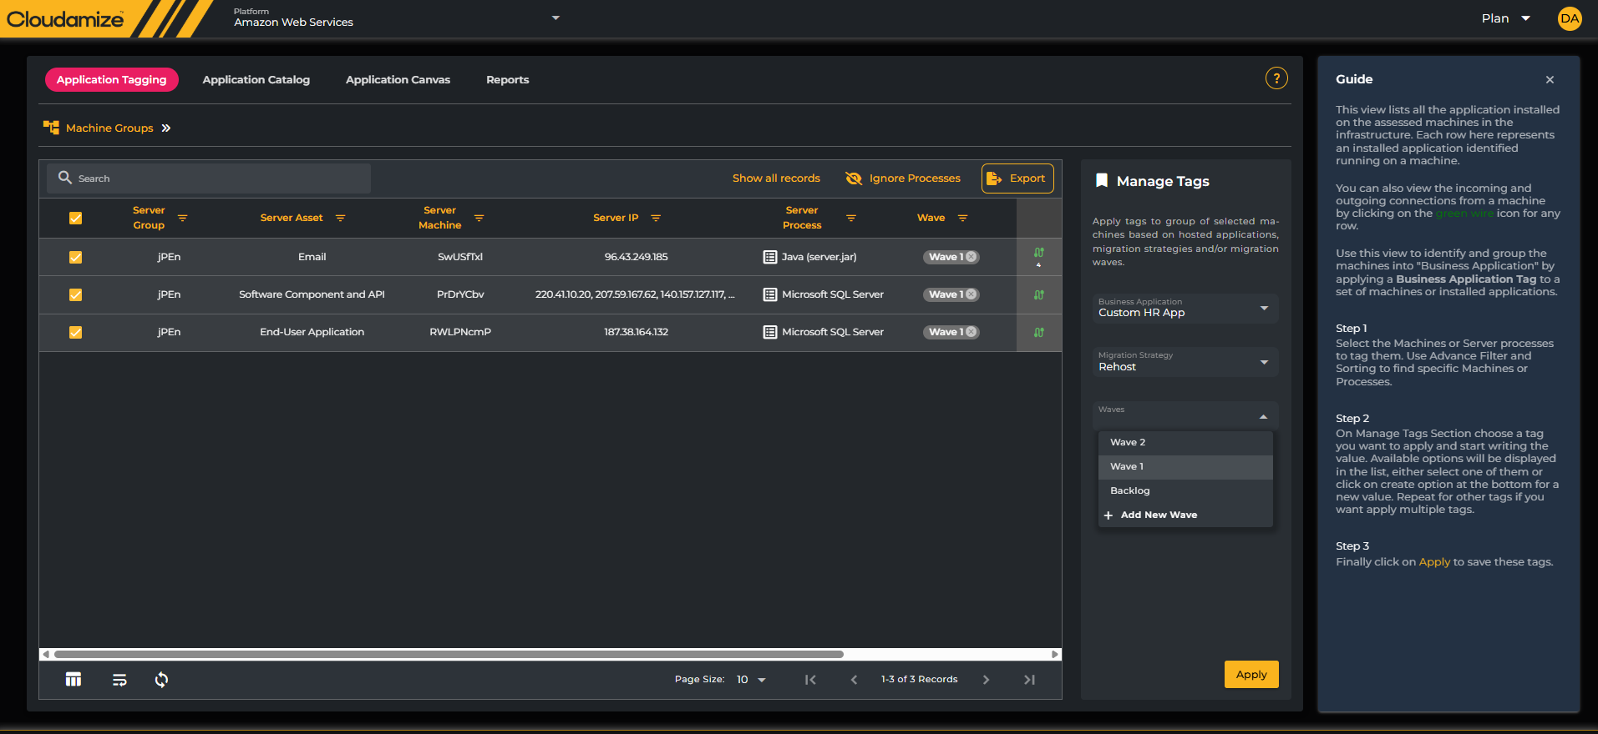
Wave, 7R, & Application Tagging
Tag/Name your application
Easily place your application into a 7R group and/or Wave
Using the dependency filter, you can easily identify and filter custom business applications

Slide 27
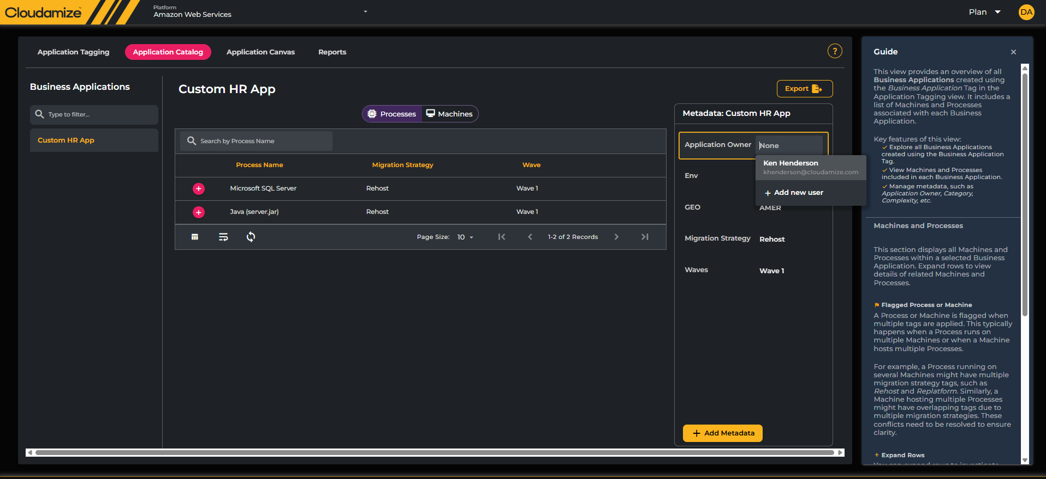
Application Catalogue
Easily set engagement users as application owners, enabling easy identification/notification of users in other platform components
Process and Machine info is automatically populated based on tagging
CMDB-like metadata can be easily defined for each application

Slide 28
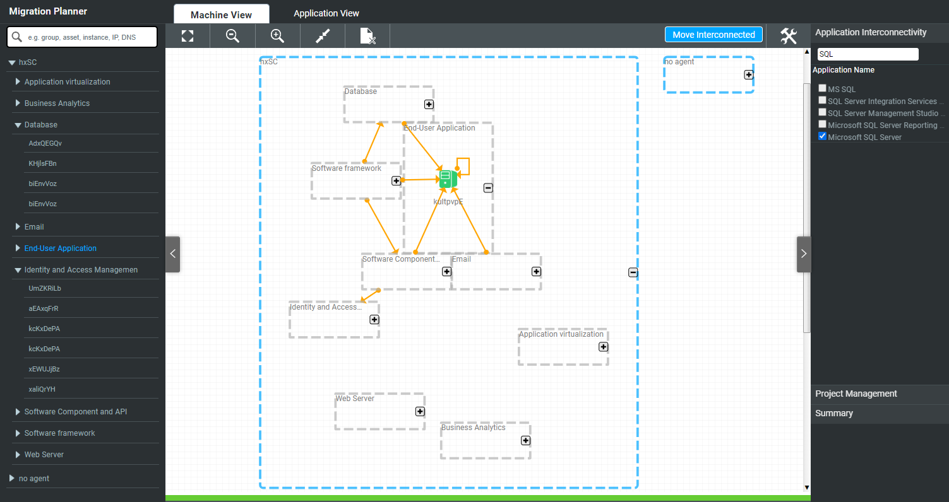
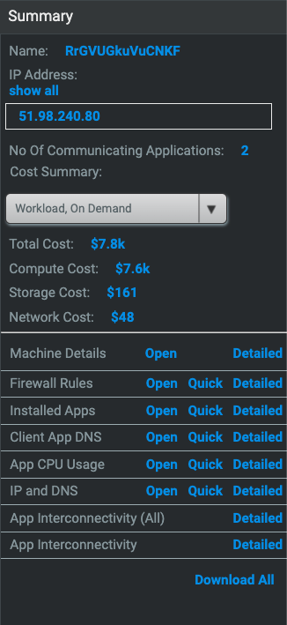
Canvas View: Application Identification
Download detailed reports at any level of grouping
Use the Application Interconnectivity feature to explore where application are being used within your estate

Slide 29
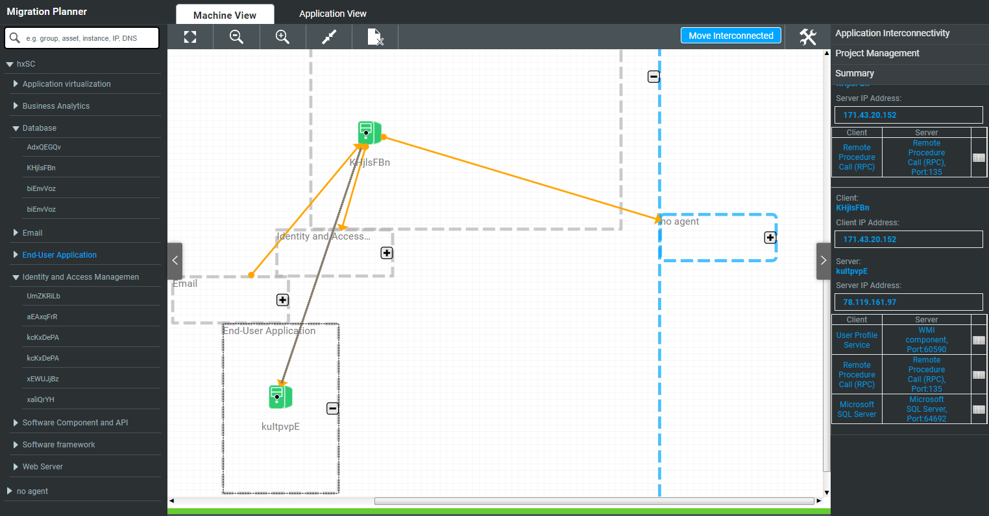
Canvas View: Application Communication
Selecting a communication line exposes all aspects of that communication in the summary tab on the right.

Slide 30
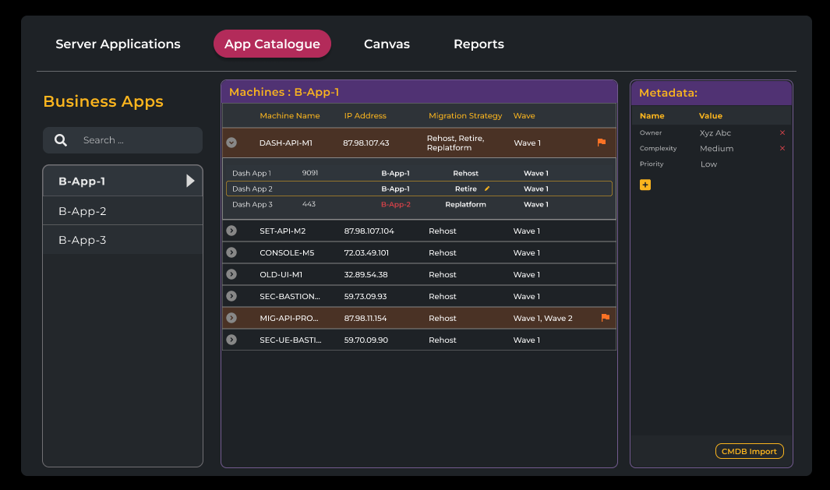



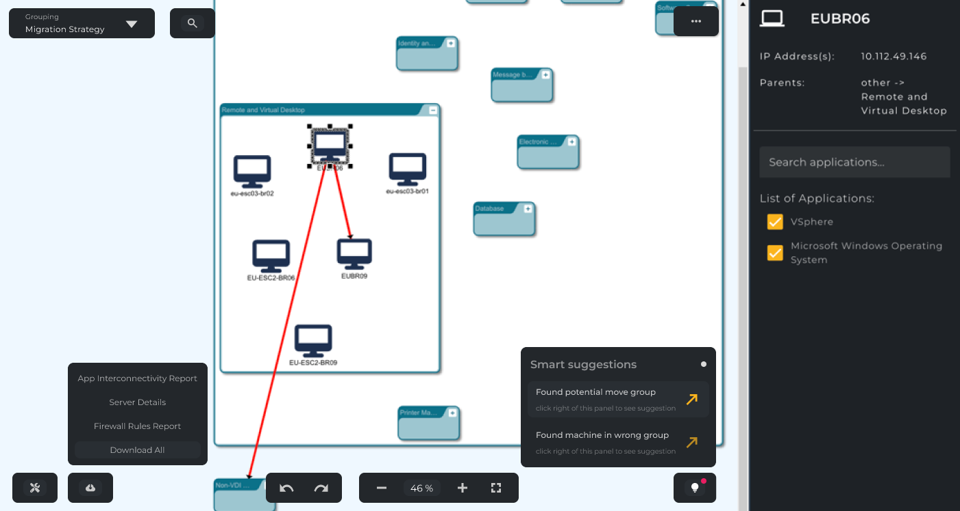
Canvas View: Next Generation
Coming in Q2 of 2026
Visualize by Move Group, Migration Strategy (7Rs), or Applications
Smart Suggestions will help expedite the grouping process by suggesting groups based on Connection Density, and highlight potential issues.

Slide 31
A2.
MANAGE

Slide 32
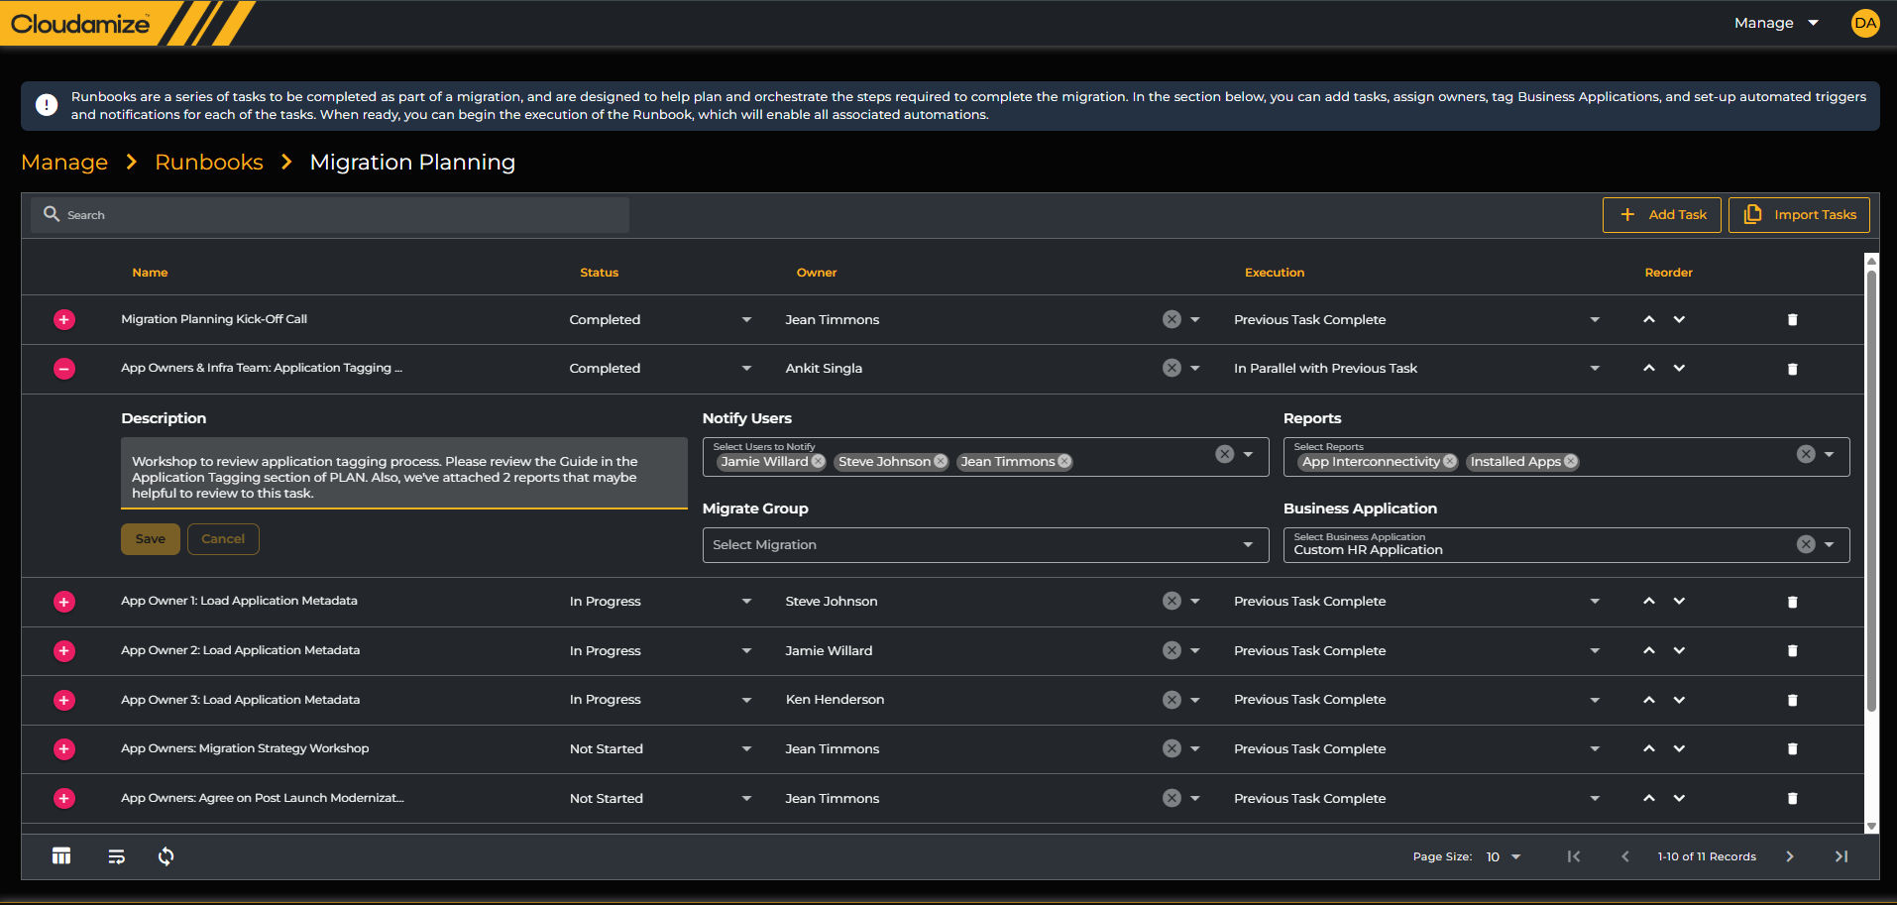
Runbooks
Add unlimited Tasks and import common tasks/templates from other Runbooks.
Set-up unlimited Runbooks. e.g. one to drive the assessment, one of the planning, and one for the migration execution
Link reports to a task
Add additional members who receive task notifications
Link Applications to a task
Automate initiating MIGRATE groups within a task
Define task owners.
Define whether the task runs in parallel with the previous task, or afterwards.

